Slide 1
STROKE RISK PREDICTION
Presented by: Sunny Rao Karegam Student ID: 20058107 Programme: MSc. Data Analytics Module: Programming for Data Analysis Lecturer: Alexander Victor

Slide 2
INTRODUCTION
What is Stroke Risk?
Stroke risk refers to the likelihood of an individual experiencing a stroke, based on factors like age, blood pressure, glucose levels, lifestyle, and medical history. Identifying high-risk individuals early is crucial for timely intervention.
Why Predict Stroke Risk?
Enables early medical intervention and prevention.
Supports doctors in making informed clinical decisions.
Reduces long-term health impacts and healthcare costs.
Project Objective
Use machine learning to predict stroke risk based on health and demographic data.
Compare models (Decision Tree, Random Forest) to determine the most accurate and reliable approach.

Slide 3
DATASET OVERVIEW
Dataset: healthcare-dataset-stroke-data.csv (5,110 records, 12 features)
Key Features:
Demographics: Age, Gender, Marital Status, Residence Type
Clinical Indicators: Hypertension, Heart Disease, Average Glucose Level, BMI
Lifestyle Factors: Smoking Status, Work Type
Stroke (Target Variable): Indicates if a patient has experienced a stroke (1 = Yes, 0 = No)
Feature Types:
Numerical: Age, BMI, Glucose Level
Categorical: Gender, Smoking Status, Work Type
Binary: Hypertension, Heart Disease, Stroke

Slide 4
DATA PREPROCESSING
Data Cleaning:
Dropped id column: Non-informative identifier.
Handled missing values: Imputed missing BMI values with the median.
Outlier Detection & Removal:
Used Interquartile Range (IQR) method.
Outliers removed from BMI and glucose level to improve model performance.
Encoding & Transformation:
Label Encoding: Converted categorical variables (e.g., gender, smoking status, work type) into numerical format.
Standardization: Applied StandardScaler to age, BMI, and glucose to normalize feature ranges.

Slide 5
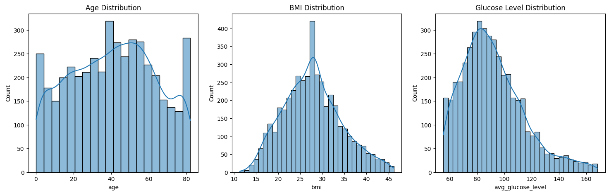
DATA VISUALIZATION
Univariate Analysis
Age Distribution: Stroke risk increases significantly with age, particularly among individuals aged 60 and above.
BMI Distribution: Most individuals fall within the 25–30 BMI range, indicating overweight but not obese.
Glucose Level Distribution: A right-skewed distribution with stroke-prone individuals often showing elevated glucose levels.

Slide 6
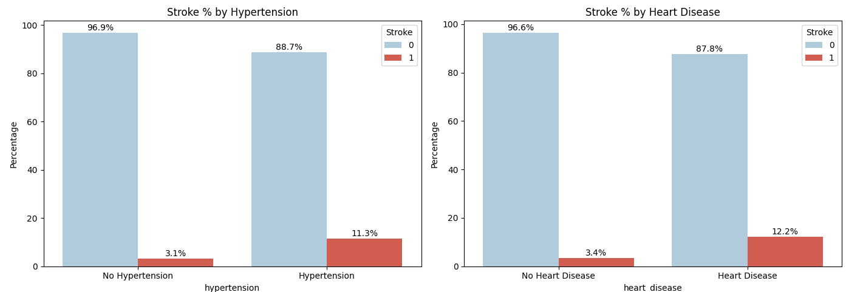
Categorical Insights: Hypertension & Heart Disease
Stroke is more common in individuals with hypertension (11.3%) than without (3.1%).
Patients with heart disease show a higher stroke rate (12.2%) compared to those without (3.4%).
Both conditions significantly increase the likelihood of stroke.

Slide 7
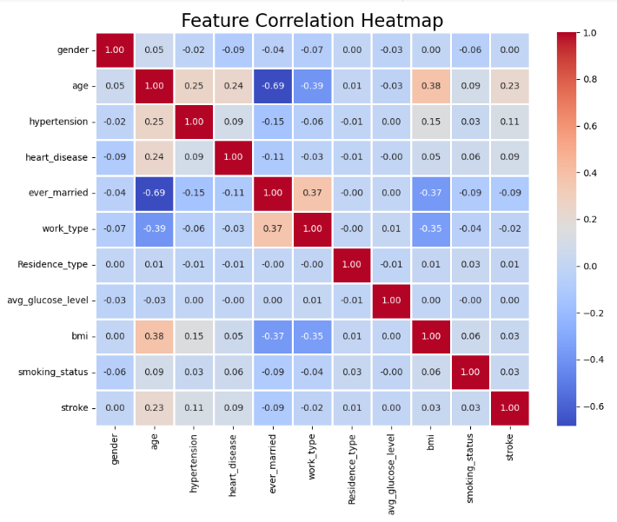
Feature Correlation Heatmap
Visualizes the relationship between stroke
And other variables in the dataset. Helps
identify features most strongly associate with stroke occurrence.
Key Insights:
Age (0.23) and average glucose level (0.13) show the strongest positive correlation with stroke, indicating they are key risk indicators.
Hypertension (0.11) and heart disease (0.09) also contribute moderately to stroke risk.
Features like gender, residence type, and work type have negligible correlation with stroke, suggesting limited predictive power.

Slide 8
MODEL BUILDING & EVALUATION
Models Used:
Decision Tree Classifier: Simple, interpretable model based on rule splits.
Random Forest Classifier: Ensemble of decision trees for higher accuracy and robustness.
Training Approach:
Train-Test Split: 80% training, 20% testing using stratified sampling.
Class Imbalance Handled with SMOTE applied to training data to balance stroke and non-stroke classes.
Result:
Random Forest outperformed Decision Tree in all metrics.
SMOTE enhanced the model's ability to detect stroke cases effectively.
Model | Accuracy | Precision | F1 Score
Decision Tree | 89.5% | 68.2% | 74.4%
Random Forest | 93.7% | 75.9% | 81.1%

Slide 9
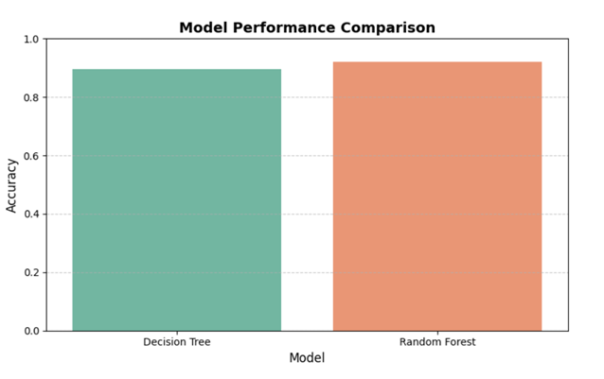
MODEL COMPARISION
The bar chart illustrates model performance based on accuracy.
Random Forest achieved a higher accuracy compared to Decision Tree, confirming its superior predictive capability.
The improvement reflects the model’s robustness, especially after addressing class imbalance with SMOTE.

Slide 10
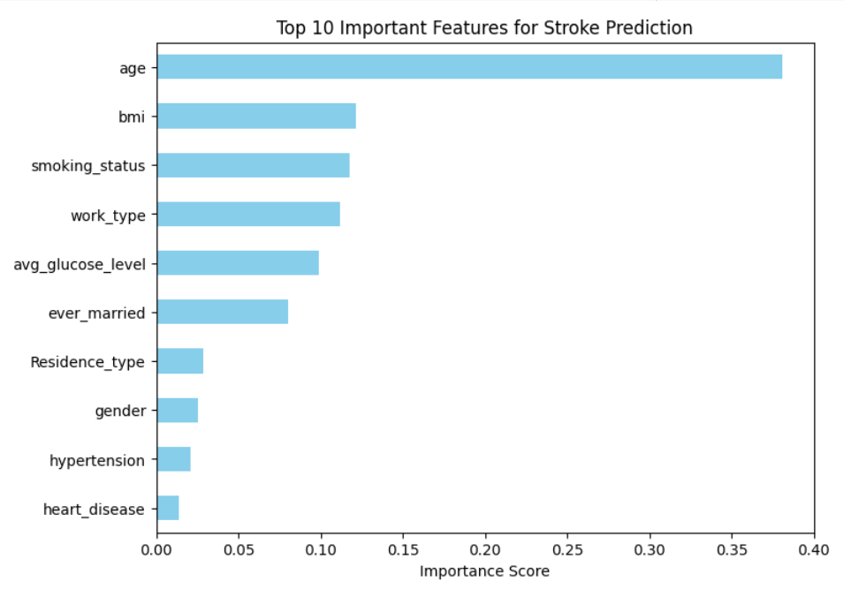
FEATURE IMPORTANCE
Age is the most significant factor influencing stroke prediction, followed by BMI, smoking status, and work type.
Clinical factors like average glucose level, hypertension, and heart disease showed lower relative importance in the model.
The Random Forest model prioritized demographic and lifestyle variables over binary health conditions in this dataset.

Slide 11
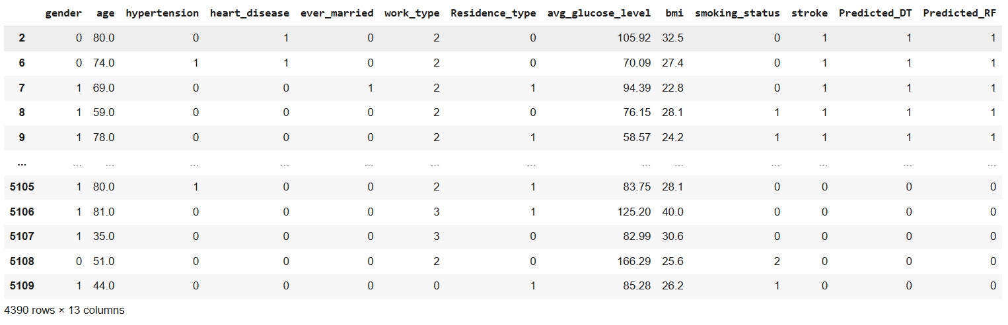
MODEL PREDICTION OUTPUT
Both Decision Tree and Random Forest models show strong alignment with actual stroke labels, with Random Forest providing slightly more consistent predictions. This confirms its superior generalization on unseen data.

Slide 12
CONCLUSION AND FUTURE SCOPE
Conclusion:
Machine learning models were successfully applied to predict stroke risk using healthcare data.
Random Forest outperformed Decision Tree, achieving higher accuracy, precision, and F1 score.
Key predictors identified include age, BMI, smoking status, and glucose level.
Applying SMOTE effectively addressed class imbalance, improving model reliability.
Future Scope:
Integrate additional clinical features (e.g., blood pressure, cholesterol, medication history).
Exploring deep learning architectures.
Develop a real-time decision support system for clinical use to enable early stroke intervention.

Slide 13
Thank You

